Slide 1

COMUNICACIÓN SERIAL - USB

Slide 2
OBJETIVOS
CONOCER LA COMUNICACIÓN SERIAL POR CABLE

Slide 3
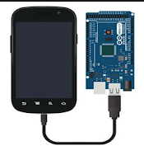
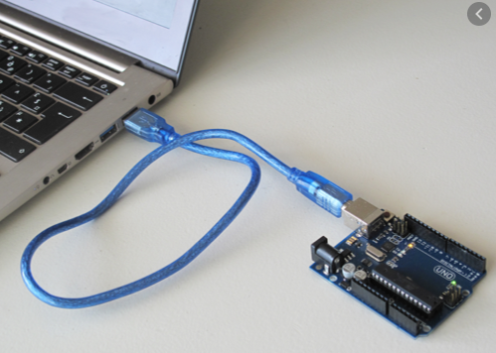
USB - OTG

Slide 4
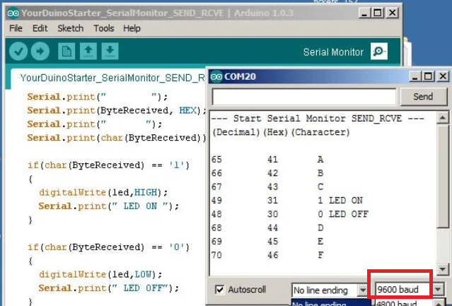
MONITOR SERIAL

Slide 5
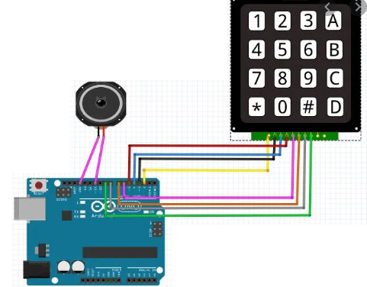
KEYBOARD 4X4 KEYPAD

Slide 6
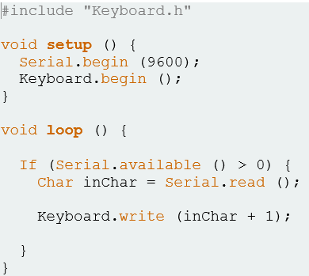
TECLADO

Slide 7

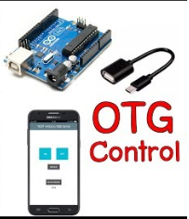
PLAY STORE APP
Arduino Android USB Serial Communication With OTG Cable

Slide 8
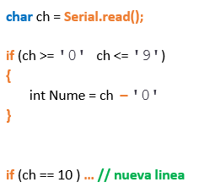
SERIAL READ

Slide 9
READ, READSTRING
String sVal1 = Serial.readString(); sVal1.trim(); // ELIMINA NEW LINE char cVal2 = Serial.read(); String cVal3 = (String)val2;
int iVal4 = Serial.read();

Slide 10
If (sVal1.trim() == “223”) …. If (cVal2 ==‘1’) ….. If (iVal4 == 64) …. ascii
COMPARAR

